Slide 1



Quality Automation:
C# – Collections Framework

Slide 2

Outline
Review “Online Shopping App” Homework
Collections Framework

Slide 3
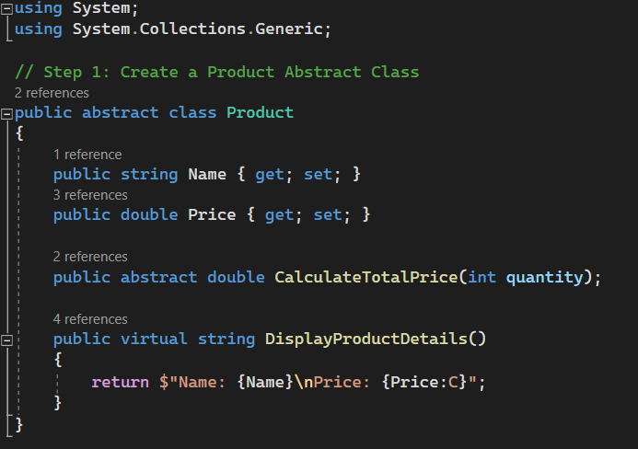
Example: Online Shopping App
Notes:
This section defines an abstract class Product that serves as the base for all product types.
The class contains properties Name and Price, which represent the common attributes of a product.
The CalculateTotalPrice method is declared as abstract, meaning each concrete product class must provide its own implementation.
The DisplayProductDetails method is marked as virtual, allowing derived classes to override it if needed. The default implementation displays the name and price of the product.

Slide 4
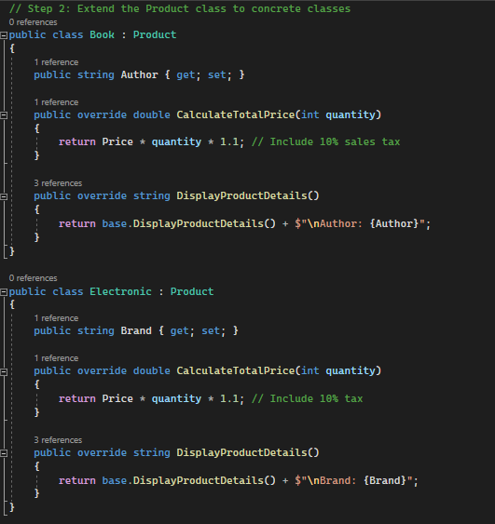
Example: Online Shopping App
Notes:
This section defines a concrete classes Book and Electronic that extends the Product abstract class.
The Book class adds an additional property Author to represent the author of the book.
The Electronic class adds an additional property Brand to represent the maker of the electronic item.
The CalculateTotalPrice method overrides the abstract method from the base class to provide the specific logic for calculating the total price of books and adds the sales tax.
The DisplayProductDetails method overrides the virtual method from the base class to include the Author and/or Brand in the displayed product details.

Slide 5
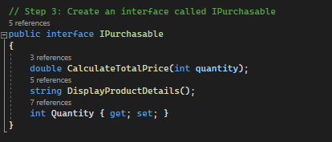
Example: Online Shopping App
Notes:
This section defines an interface called IPurchasable that declares the necessary methods and properties for a purchasable item.
The interface includes the CalculateTotalPrice and DisplayProductDetails method signatures that should be implemented by classes that implement the interface.
The Quantity property is also included in the interface to represent the quantity of the product.

Slide 6
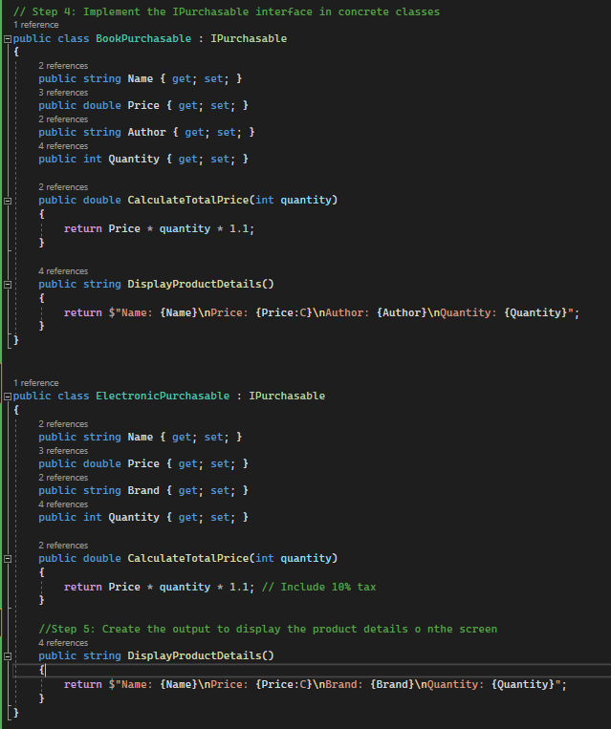
Example: Online Shopping App
Notes:
This section implements the IPurchasable interface for the BookPurchasable class.
The class includes properties Name, Price, Author, and Quantity, which represent the attributes of a book.
The CalculateTotalPrice method implements the interface method to calculate the total price of books based on the given quantity.
The DisplayProductDetails method implements the interface method to display the details of the book, including the name, price, author, and quantity.
This section also implements the IPurchasable interface for the ElectronicPurchasable class.
The class includes properties Name, Price, Brand, and Quantity, which represent the attributes of an electronic product.
Again, The CalculateTotalPrice method implements the interface method to calculate the total price of electronic products based on the given quantity, including a 10% tax.
DisplayProductDetails implements the interface method to display the details of the electronic product, including the name, price, brand, and quantity.

Slide 7
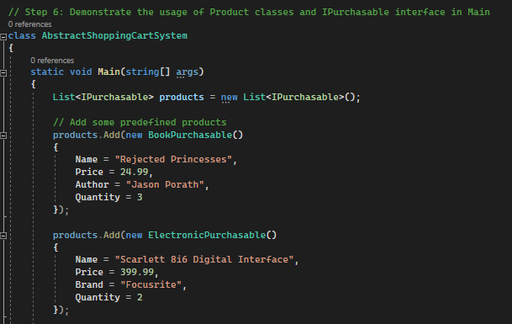
Example: Online Shopping App
Notes:
This section contains the Main method.
The method creates a list of IPurchasable products and adds some predefined products (a book and an electronic item) to the list.
he program displays the available product options by iterating through the list and calling the DisplayProductDetails method for each product.

Slide 8
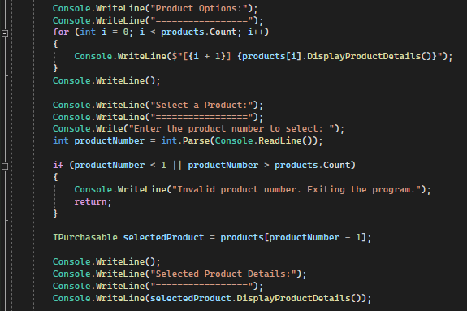
Example: Online Shopping App
Notes:
The user is prompted to select a product by entering the corresponding number.
The program validates the user's input and retrieves the selected product.
The selected product details are displayed using the DisplayProductDetails method.

Slide 9
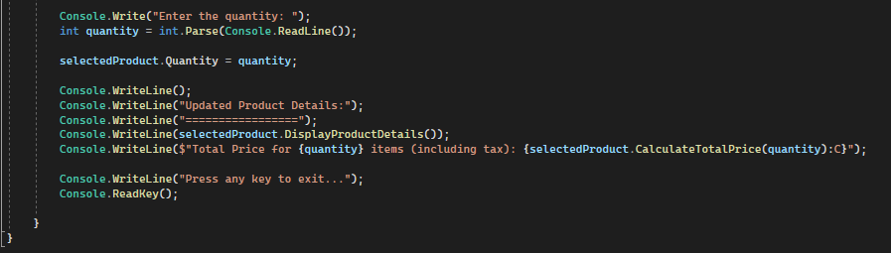
Example: Online Shopping App
Notes:
The user is prompted to enter the quantity for the selected product.
The quantity is updated in the selected product object.
The program displays the updated product details and calculates the total price using the CalculateTotalPrice method, including any applicable tax.
Finally, the program waits for user input before exiting.

Slide 10

Collections Framework
Collection: Object that represents a group of objects.
Reduce Programmer Effort
Increases Performance
Provides Interoperability Between Unrelated APIs
Reduces the Effort to Learn APIs
Reduces the Effort Required to Design and Implement APIs
Fosters Software Reuse
https://docs.oracle.com/javase/8/docs/technotes/guides/collections/overview.html
Notes:
In C#, the collections framework is primarily built around the System.Collections and System.Collections.Generic namespaces. These namespaces provide a set of classes and interfaces that allow you to work with various types of collections, such as lists, dictionaries, queues, stacks, and more.
The relevance of the points mentioned in the passage can be presented as follows for C#:
Reduces programming effort: C# collections framework provides ready-to-use data structures and algorithms, saving you from implementing them yourself. You can choose from a wide range of collection types based on your requirements.
Increases performance: C# collections framework offers high-performance implementations of data structures and algorithms. The framework is designed to be efficient and provides optimized implementations, allowing you to process and manipulate collections efficiently.
Provides interoperability between unrelated APIs: C# collections framework provides a common language to pass collections between different parts of your code or even between different APIs. You can use the standard collection interfaces to ensure compatibility and ease of integration.
Reduces the effort required to learn APIs: By utilizing the C# collections framework, you only need to learn and understand the common collection interfaces and their methods. Once you are familiar with these interfaces, you can easily work with different collection types without the need to learn multiple ad hoc collection APIs.
Reduces the effort required to design and implement APIs: C# collections framework eliminates the need to create ad hoc collection APIs. Instead, you can rely on the standard interfaces provided by the framework, allowing you to focus on the design and implementation of your specific APIs without worrying about low-level collection details.
Fosters software reuse: The C# collections framework promotes software reuse by providing a standard interface for collections and algorithms. This allows you to write reusable code that can work with any collection implementing the standard interfaces. You can easily swap out different collection implementations without modifying the code that uses them.

Slide 11
Collection Framework Components
Interfaces
Classes
Algorithms and Utilities
Notes:
The key components of the C# Collections Framework consists of the following:
Interfaces:
Collection: In C#, the interface is ICollection<T>, which defines the common operations for working with collections.
List: C# provides the List<T> class, which represents an ordered collection that allows duplicate elements.
Set: C# includes the HashSet<T> class, which represents a collection that does not allow duplicate elements.
Queue: C# offers the Queue<T> class, which represents a collection that follows the FIFO (First-In-First-Out) order.
LinkedList: C# let’s you use use the LinkedList<T> for insertion and deletion of elements from the list at a fast pace.
Dictionary: C# provides the Dictionary<TKey, TValue> class, which maps keys to values. It allows unique keys and efficient key-value pair storage and retrieval.
Classes:
ArrayList: C# provides the List<T> class. It implements the List interface using an array and allows dynamic resizing.
LinkedList: C# includes the LinkedList<T> class, which implements the LinkedList interface using a doubly linked list.
HashSet: C# offers the HashSet<T> class. It implements the Set interface using a hash table and provides constant-time performance for basic operations.
SortedSet: C# has the SortedSet<T> interface along with a custom implementation based on a self-balancing binary search tree.
Dictionary: C# provides the Dictionary<TKey, TValue> class. It allows efficient key-value pair storage and retrieval.
SortedDictionary: C# let’s you use the SortedDictionary<TKey, TValue> class along with a custom implementation based on a self-balancing binary search tree to achieve similar functionality.
Algorithms and Utilities:
The System.Linq namespace provides powerful query operators, such as sorting (OrderBy, OrderByDescending), searching (FirstOrDefault, LastOrDefault), shuffling (OrderBy with a random key), and manipulating elements (Where, Select, Skip, Take, etc.).
The System.Collections.Generic.List<T>, System.Collections.Generic.Dictionary<TKey, TValue>, and System.Array offer methods for working with collections.

Slide 12
Differences between collection sets and Lists
 | SET | LIST
Duplication of Elements | No duplicates | Allows duplicates
Order of Elements | Not ordered | Preserves ordering of elements
Element Access | Accessed via iteration (no direct access) | Access using index or random access
Use Case | Use when uniqueness matters and order isn’t a concern | Use when order of elements matters and duplicates are allowed
Performance | HashSet provides constant-time performance | provide efficient random access by index
Notes:
In C#, both Set and List are interfaces that are part of the .NET Collections Framework. They represent different types of collections with distinct characteristics and usage scenarios. Here's the difference between a Set and a List in C#:
Duplication of Elements:
Set: Does not allow duplicate elements. Each element in a set must be unique. Adding a duplicate element to a set has no effect.
List: Allows duplicate elements. Elements can be added to a list multiple times, and they will be stored in the order they were added.
Order of Elements:
Set: Does not guarantee a specific order of elements. The order of elements in a set may be different from the order in which they were added. Implementations like HashSet provide unordered sets.
List: Preserves the order of elements. Elements in a list are stored sequentially according to their insertion order. The order remains the same unless explicitly modified.
Element Access:
Set: Elements in a set are accessed by iterating through the set, as sets do not provide direct access by index.
List: Elements in a list can be accessed using their index. List implementations like List<T> support random access, allowing efficient retrieval of elements by index.
Use Cases:
Set: Sets are commonly used when uniqueness of elements is important, and the specific order of elements is not a concern. They are useful for eliminating duplicates and performing set-based operations like union, intersection, and difference.
List: Lists are used when the order of elements matters and duplicate elements are allowed. They are suitable for scenarios where elements need to be stored and accessed in a specific sequence, such as maintaining a collection of items or implementing data structures like stacks or queues.
Performance:
Set: Depending on the specific set implementation, the performance characteristics can vary. Implementations like HashSet provide constant-time performance for basic operations.
List: List implementations like List<T> provide efficient random access by index, enabling constant-time performance for retrieval operations. However, operations like insertion or removal at arbitrary positions provide efficient random access by index of O(n).

Slide 13

Commonly used Interfaces
Notes:
Interfaces:
ICollection<T>: The root interface that defines the common operations for working with collections in C#.
IList<T>: An ordered collection that allows duplicate elements. It provides methods for indexing and manipulating elements in the list.
ISet<T>: A collection that does not allow duplicate elements. It provides methods for working with sets and performing set-based operations like union, intersection, and difference. IQueue<T>: A collection that represents a waiting list and follows the FIFO (First-In-First-Out) order. It provides methods for enqueueing and dequeueing elements.
IDeque<T>: A double-ended queue that allows element insertion and removal at both ends. It provides methods for working with a queue-like structure where elements can be added or removed from either end.
IDictionary<TKey, TValue>: An object that maps keys to values, where each key is unique. It provides methods for working with key/value pairs.
IEnumerator<T>: An interface for iterating over elements in a collection. It provides methods for traversing the collection and retrieving elements one by one.
Classes:
List<T>: Implements the IList<T> interface using an array and allows dynamic resizing. It provides methods for working with lists of elements.
HashSet<T>: Implements the ISet<T> interface using a hash table and provides constant-time performance for basic operations. It ensures uniqueness of elements.
Queue<T>: Implements the IQueue<T> interface using a linked list or an array-based circular buffer. It follows the FIFO order.
Stack<T>: Implements the IStack<T> interface using a linked list or an array. It represents a stack data structure with LIFO (Last-In-First-Out) order.
Dictionary<TKey, TValue>: Implements the IDictionary<TKey, TValue> interface using a hash table. It allows efficient storage and retrieval of key/value pairs based on keys.
LinkedList<T>: Implements the ICollection<T>, IList<T>, and IDeque<T> interfaces using a doubly linked list. It allows efficient insertion and removal at both ends.
SortedSet<T>: Implements the ISet<T> interface using a self-balancing binary search tree. It keeps elements sorted based on their natural order or a custom comparer.
SortedDictionary<TKey, TValue>: Implements the IDictionary<TKey, TValue> interface using a self-balancing binary search tree. It keeps keys sorted based on their natural order or a custom comparer.
Queue<T>: Implements the IQueue<T> interface using a linked list or an array-based circular buffer. It follows the FIFO order.
Stack<T>: Implements the IStack<T> interface using a linked list or an array. It represents a stack data structure with LIFO (Last-In-First-Out) order.
LinkedList<T>: Implements the ICollection<T>, IList<T>, and `IDeque<T> interfaces using a doubly linked list. It allows efficient insertion and removal at both ends.
SortedSet<T>: Implements the ISet<T> interface using a self-balancing binary search tree. It keeps elements sorted based on their natural order or a custom comparer.
SortedDictionary<TKey, TValue>: Implements the IDictionary<TKey, TValue> interface using a self-balancing binary search tree. It keeps keys sorted based on their natural order or a custom comparer.

Slide 14

Demo: Collections
Build out new main class to call demos
Build out and demonstrate a HashSET
Build out and demonstrate an ArrayList
Build out and demonstrate a LinkedList
Build out and demonstrate an ImmutableList
Notes:
using System;
using System.Collections.Generic;
class CollectionsDemoExamples
{
static void Main(string[] args)
{
// DEMO HASHSET: Create a HashSet to store names
DemoHashSet();
Console.WriteLine("*********************************************");
// Create an ArrayList to store integers
DemoArrayList();
Console.WriteLine("*********************************************");
// Create a LinkedList to represent a shopping cart
DemoLinkedList();
Console.WriteLine("*********************************************");
// Create a Dictionary to represent a contact list
DemoDictionary();
Console.WriteLine("*********************************************");
// Create an immutable collection using List.Of method
DemoImmutableList();
Console.WriteLine("Press any key to exit...");
Console.ReadKey();
}
public static void DemoHashSet()
{
HashSet<string> namesSet = new HashSet<string>();
// Add elements to the HashSet
namesSet.Add("Alice");
namesSet.Add("Bob");
namesSet.Add("Charlie");
namesSet.Add("Alice"); // Adding a duplicate element (ignored in a HashSet)
// Display the size of the HashSet
Console.WriteLine("Size of the HashSet: " + namesSet.Count);
// Display all elements in the HashSet
Console.WriteLine("Elements in the HashSet:");
foreach (var name in namesSet)
{
Console.WriteLine(name);
}
// Check if an element is present in the HashSet
bool containsBob = namesSet.Contains("Bob");
Console.WriteLine("HashSet contains Bob: " + containsBob);
// Remove an element from the HashSet
namesSet.Remove("Charlie");
// Display the size of the HashSet
Console.WriteLine("Size of the HashSet: " + namesSet.Count);
// Display all elements in the HashSet
Console.WriteLine("Elements in the HashSet:");
foreach (var name in namesSet)
{
Console.WriteLine(name);
}
}
public static void DemoArrayList()
{
List<int> numbersList = new List<int>();
// Add elements to the List
numbersList.Add(10);
numbersList.Add(20);
numbersList.Add(30);
numbersList.Add(40);
numbersList.Add(10); // Adding a duplicate to show the support for having duplicate values in a list
// Display the size of the List
Console.WriteLine("Size of the List: " + numbersList.Count);
// Display the size of the List
Console.WriteLine("Size of the List: " + numbersList.Count);
// Access an element at a specific index
int elementAtIndex2 = numbersList[2];
Console.WriteLine("Element at index 2: " + elementAtIndex2);
// Modify an element at a specific index
numbersList[1] = 50;
// Access an element at a specific index
int elementAtIndex1 = numbersList[1];
Console.WriteLine("Element at index 1: " + elementAtIndex1);
// Remove an element at a specific index
Console.WriteLine("Removing: " + numbersList[3]);
numbersList.RemoveAt(3);
// Display all elements in the List
Console.WriteLine("Elements in the List:");
foreach (var number in numbersList)
{
Console.WriteLine(number);
}
// Display a sublist of items from the List
Console.WriteLine("Sublist of items from the List:");
List<int> sublist = numbersList.GetRange(2, 2);
foreach (var number in sublist)
{
Console.WriteLine(number);
}
}
public static void DemoLinkedList()
{
LinkedList<string> shoppingCart = new LinkedList<string>();
// Add items to the shopping cart
shoppingCart.AddLast("Shirt");
shoppingCart.AddLast("5");
shoppingCart.AddLast("Shoes");
shoppingCart.AddLast("Hat");
shoppingCart.AddLast("10");
// Display the items in the shopping cart
Console.WriteLine("Items in the shopping cart:");
foreach (var item in shoppingCart)
{
Console.WriteLine(item);
}
// Check if an item is in the shopping cart
bool containsHat = shoppingCart.Contains("Hat");
Console.WriteLine("Shopping cart contains Hat: " + containsHat);
// Remove an item from the shopping cart
shoppingCart.Remove("Hat");
// Check if an item is still in the shopping cart
containsHat = shoppingCart.Contains("Hat");
Console.WriteLine("Shopping cart contains Hat: " + containsHat);
// Manually find the index of an item in the shopping cart
int jeansIndex = FindLinkedListIndex(shoppingCart, "Jeans");
Console.WriteLine("Index of Jeans in the shopping cart: " + jeansIndex);
// Modify an item in the shopping cart
shoppingCart.AddFirst("T-Shirt");
shoppingCart.RemoveLast();
// Display the updated items in the shopping cart
Console.WriteLine("Updated items in the shopping cart:");
foreach (var item in shoppingCart)
{
Console.WriteLine(item);
}
}
public static int FindLinkedListIndex<T>(LinkedList<T> linkedList, T item)
{
int index = 0;
foreach (var listItem in linkedList)
{
if (EqualityComparer<T>.Default.Equals(listItem, item))
{
return index;
}
index++;
}
return -1; // Item not found
}
public static void DemoDictionary()
{
Dictionary<string, string> contactList = new Dictionary<string, string>();
// Add contacts to the Dictionary
contactList["John"] = "john@example.com";
contactList["Alice"] = "alice@example.com";
contactList["Bob"] = "bob@example.com";
contactList["Jacob"] = "jacob@mmc.com";
// Display all contacts in the contact list
Console.WriteLine("Contacts in the contact list:");
foreach (var entry in contactList)
{
Console.WriteLine(entry.Key + ": " + entry.Value);
}
// Accessing a specific contact's email
string johnEmail = contactList["John"];
Console.WriteLine("Email of John: " + johnEmail);
// Check if a contact is present in the contact list
bool containsAlice = contactList.ContainsKey("Alice");
Console.WriteLine("Contact list contains Alice: " + containsAlice);
// Remove a contact from the contact list
contactList.Remove("Bob");
// Display the updated contacts in the contact list
Console.WriteLine("Updated contacts in the contact list:");
foreach (var entry in contactList)
{
Console.WriteLine(entry.Key + ": " + entry.Value);
}
}
public static void DemoImmutableList()
{
List<string> fruitsList = new List<string> { "Apple", "Banana", "Orange" };
// Display the elements in the List
Console.WriteLine("Elements in the List:");
foreach (var fruit in fruitsList)
{
Console.WriteLine(fruit);
}
}
}

Slide 15
Demo: Collections
Build out new main class to call demos
Build out and demonstrate a HashSET
Build out and demonstrate an ArrayList
Build out and demonstrate a LinkedList
Build out and demonstrate an ImmutableList
Notes:
using System;
using System.Collections.Generic;
class CollectionsDemoExamples
{
static void Main(string[] args)
{
// DEMO HASHSET: Create a HashSet to store names
DemoHashSet();
Console.WriteLine("*********************************************");
// Create an ArrayList to store integers
DemoArrayList();
Console.WriteLine("*********************************************");
// Create a LinkedList to represent a shopping cart
DemoLinkedList();
Console.WriteLine("*********************************************");
// Create a Dictionary to represent a contact list
DemoDictionary();
Console.WriteLine("*********************************************");
// Create an immutable collection using List.Of method
DemoImmutableList();
Console.WriteLine("Press any key to exit...");
Console.ReadKey();
}
public static void DemoHashSet()
{
HashSet<string> namesSet = new HashSet<string>();
// Add elements to the HashSet
namesSet.Add("Alice");
namesSet.Add("Bob");
namesSet.Add("Charlie");
namesSet.Add("Alice"); // Adding a duplicate element (ignored in a HashSet)
// Display the size of the HashSet
Console.WriteLine("Size of the HashSet: " + namesSet.Count);
// Display all elements in the HashSet
Console.WriteLine("Elements in the HashSet:");
foreach (var name in namesSet)
{
Console.WriteLine(name);
}
// Check if an element is present in the HashSet
bool containsBob = namesSet.Contains("Bob");
Console.WriteLine("HashSet contains Bob: " + containsBob);
// Remove an element from the HashSet
namesSet.Remove("Charlie");
// Display the size of the HashSet
Console.WriteLine("Size of the HashSet: " + namesSet.Count);
// Display all elements in the HashSet
Console.WriteLine("Elements in the HashSet:");
foreach (var name in namesSet)
{
Console.WriteLine(name);
}
}
public static void DemoArrayList()
{
List<int> numbersList = new List<int>();
// Add elements to the List
numbersList.Add(10);
numbersList.Add(20);
numbersList.Add(30);
numbersList.Add(40);
numbersList.Add(10); // Adding a duplicate to show the support for having duplicate values in a list
// Display the size of the List
Console.WriteLine("Size of the List: " + numbersList.Count);
// Display the size of the List
Console.WriteLine("Size of the List: " + numbersList.Count);
// Access an element at a specific index
int elementAtIndex2 = numbersList[2];
Console.WriteLine("Element at index 2: " + elementAtIndex2);
// Modify an element at a specific index
numbersList[1] = 50;
// Access an element at a specific index
int elementAtIndex1 = numbersList[1];
Console.WriteLine("Element at index 1: " + elementAtIndex1);
// Remove an element at a specific index
Console.WriteLine("Removing: " + numbersList[3]);
numbersList.RemoveAt(3);
// Display all elements in the List
Console.WriteLine("Elements in the List:");
foreach (var number in numbersList)
{
Console.WriteLine(number);
}
// Display a sublist of items from the List
Console.WriteLine("Sublist of items from the List:");
List<int> sublist = numbersList.GetRange(2, 2);
foreach (var number in sublist)
{
Console.WriteLine(number);
}
}
public static void DemoLinkedList()
{
LinkedList<string> shoppingCart = new LinkedList<string>();
// Add items to the shopping cart
shoppingCart.AddLast("Shirt");
shoppingCart.AddLast("5");
shoppingCart.AddLast("Shoes");
shoppingCart.AddLast("Hat");
shoppingCart.AddLast("10");
// Display the items in the shopping cart
Console.WriteLine("Items in the shopping cart:");
foreach (var item in shoppingCart)
{
Console.WriteLine(item);
}
// Check if an item is in the shopping cart
bool containsHat = shoppingCart.Contains("Hat");
Console.WriteLine("Shopping cart contains Hat: " + containsHat);
// Remove an item from the shopping cart
shoppingCart.Remove("Hat");
// Check if an item is still in the shopping cart
containsHat = shoppingCart.Contains("Hat");
Console.WriteLine("Shopping cart contains Hat: " + containsHat);
// Manually find the index of an item in the shopping cart
int jeansIndex = FindLinkedListIndex(shoppingCart, "Jeans");
Console.WriteLine("Index of Jeans in the shopping cart: " + jeansIndex);
// Modify an item in the shopping cart
shoppingCart.AddFirst("T-Shirt");
shoppingCart.RemoveLast();
// Display the updated items in the shopping cart
Console.WriteLine("Updated items in the shopping cart:");
foreach (var item in shoppingCart)
{
Console.WriteLine(item);
}
}
public static int FindLinkedListIndex<T>(LinkedList<T> linkedList, T item)
{
int index = 0;
foreach (var listItem in linkedList)
{
if (EqualityComparer<T>.Default.Equals(listItem, item))
{
return index;
}
index++;
}
return -1; // Item not found
}
public static void DemoDictionary()
{
Dictionary<string, string> contactList = new Dictionary<string, string>();
// Add contacts to the Dictionary
contactList["John"] = "john@example.com";
contactList["Alice"] = "alice@example.com";
contactList["Bob"] = "bob@example.com";
contactList["Jacob"] = "jacob@mmc.com";
// Display all contacts in the contact list
Console.WriteLine("Contacts in the contact list:");
foreach (var entry in contactList)
{
Console.WriteLine(entry.Key + ": " + entry.Value);
}
// Accessing a specific contact's email
string johnEmail = contactList["John"];
Console.WriteLine("Email of John: " + johnEmail);
// Check if a contact is present in the contact list
bool containsAlice = contactList.ContainsKey("Alice");
Console.WriteLine("Contact list contains Alice: " + containsAlice);
// Remove a contact from the contact list
contactList.Remove("Bob");
// Display the updated contacts in the contact list
Console.WriteLine("Updated contacts in the contact list:");
foreach (var entry in contactList)
{
Console.WriteLine(entry.Key + ": " + entry.Value);
}
}
public static void DemoImmutableList()
{
List<string> fruitsList = new List<string> { "Apple", "Banana", "Orange" };
// Display the elements in the List
Console.WriteLine("Elements in the List:");
foreach (var fruit in fruitsList)
{
Console.WriteLine(fruit);
}
}
}
Main method: Calls various methods to demonstrate different collections.
DemoHashSet method: Creates a HashSet<string> called namesSet. It adds elements to the HashSet, including a duplicate (which is ignored in a HashSet). It demonstrates the count of elements, iterating over the set, checking for a specific element, removing an element, and displaying the updated set.
DemoArrayList method: Creates a List<int> called numbersList. It adds elements to the list, including a duplicate. It demonstrates the count of elements, accessing elements by index, modifying an element, removing an element at a specific index, displaying the list, and creating a sublist from the list.
DemoLinkedList method: Creates a LinkedList<string> called shoppingCart. It adds items to the shopping cart, demonstrates iterating over the cart, checking for an item, removing an item, manually finding the index of an item, modifying items, and displaying the updated shopping cart.
FindLinkedListIndex method: A helper method to find the index of an item in a linked list. It iterates over the linked list and returns the index of the item if found.
DemoDictionary method: Creates a Dictionary<string, string> called contactList. It adds contacts to the dictionary, demonstrates iterating over the dictionary, accessing a specific contact's value, checking for a contact, removing a contact, and displaying the updated dictionary.
DemoImmutableList method: Creates an immutable list fruitsList using the List<T>.Of method. It demonstrates iterating over the list and displaying its elements.

Slide 16

Demo: Looping with Collections
Add and demo While Loop
Add and demo For loop
Add and Demo Enhanced For Loop
Add and Demo .forEach Loop
Notes:
using System;
using System.Collections.Generic;
using System.Linq;
class Program
{
static void Main(string[] args)
{
HashSet<string> namesSet = new HashSet<string>()
{
"Alice",
"Bob",
"Charlie"
};
List<int> numbersList = new List<int>()
{
10,
20,
30,
40
};
LinkedList<string> shoppingCart = new LinkedList<string>();
shoppingCart.AddLast("Shirt");
shoppingCart.AddLast("Shoes");
shoppingCart.AddLast("Hat");
Dictionary<string, string> contactList = new Dictionary<string, string>()
{
{ "John", "john@example.com" },
{ "Alice", "alice@example.com" },
{ "Bob", "bob@example.com" }
};
// DEMO HASHSET: Create a HashSet to store names
Console.WriteLine("HashSet:");
Console.WriteLine("Size of the HashSet: " + namesSet.Count);
Console.WriteLine("HashSet contains Bob: " + namesSet.Contains("Bob"));
Console.WriteLine("Elements in the HashSet using for loop:");
for (int i = 0; i < namesSet.Count; i++)
{
string name = namesSet.ElementAt(i);
Console.WriteLine(name);
}
Console.WriteLine();
// DEMO LIST: Create an ArrayList to store integers
Console.WriteLine("ArrayList:");
Console.WriteLine("Size of the ArrayList: " + numbersList.Count);
Console.WriteLine("Element at index 2: " + numbersList[2]);
numbersList[1] = 50;
Console.WriteLine("Removing: " + numbersList[3]);
numbersList.RemoveAt(3);
Console.WriteLine("Elements in the ArrayList using while loop:");
int index = 0;
while (index < numbersList.Count)
{
Console.WriteLine(numbersList[index]);
index++;
}
Console.WriteLine();
// DEMO LINKEDLIST: Create a LinkedList to represent a shopping cart
Console.WriteLine("LinkedList:");
Console.WriteLine("Items in the shopping cart using do-while loop:");
LinkedListNode<string> currentNode = shoppingCart.First;
do
{
Console.WriteLine(currentNode.Value);
currentNode = currentNode.Next;
} while (currentNode != null);
shoppingCart.Remove("Shoes");
Console.WriteLine("Last Item in Cart: " + shoppingCart.Last.Value);
Console.WriteLine("First Item in Cart: " + shoppingCart.First.Value);
Console.WriteLine("Shopping cart contains Hat: " + shoppingCart.Contains("Hat"));
Console.WriteLine("Updated items in the shopping cart using foreach loop:");
foreach (string item in shoppingCart)
{
Console.WriteLine(item);
}
Console.WriteLine();
// DEMO DICTIONARY: Create a Dictionary to represent a contact list
Console.WriteLine("Dictionary:");
Console.WriteLine("Contacts in the contact list using foreach loop:");
foreach (KeyValuePair<string, string> entry in contactList)
{
Console.WriteLine("Name: " + entry.Key + ", Email: " + entry.Value);
}
Console.WriteLine();
// DEMO LOOPS:
Console.WriteLine("Loops:");
Console.WriteLine("Iterator method while loop output");
var iterator = namesSet.GetEnumerator();
while (iterator.MoveNext())
{
Console.WriteLine(iterator.Current);
}
Console.WriteLine("For loop output");
for (int i = 0; i < numbersList.Count; i++)
{
Console.WriteLine(numbersList[i]);
}
Console.WriteLine("Enhanced foreach loop output");
foreach (string name in namesSet)
{
Console.WriteLine("Name: " + name);
}
Console.WriteLine("Press any key to exit...");
Console.ReadKey();
}
}
In the HashSet example, we use for loop to iterate over the elements using the index.
In the ArrayList example, we use a while loop that uses an index to iterate over the elements.
In the LinkedList example, we use a do-while loop to iterate over the shopping cart's items, starting from the first node and moving to the next until the end.
In the Dictionary example, we use a foreach loop.

Slide 17

Homework: Music Library App
Scenario: You will build a music library management system that allows users to organize and manage their music collection. The system should support adding songs, creating playlists, and performing operations on the music library.
Requirements:
Implement all classes for appropriate objects associated with the business problem. (Song, Library, etc.)
Library class that acts as the main interface for the music library management system. It should contain appropriate methods to add songs, create playlists, and perform operations on the music library.
Use at least 3 different types of Java Collection framework classes to store the music library and playlists.
Application should support the following functionality
Add a song to the music library
Create a playlist and add songs to it.
Display all songs in the music library.
Display all playlists and their associated songs.
Find all songs by a specific artist.
Test the program by adding sample songs, creating playlists, and verifying the functionality of the music library management system and push finalized code to your personal Github Dev Branch and create a pull request assigned to instructor for review.

